Slide 1

The governance of the Cities’ Nighttime Policies
Thierry CHARLOIS
Project manager for Nighttime Policy, City of Paris
COPERATIVE SOCIALE - 28 APR NOTTE DI QUALITÀ: LA FORMAZIONE 2023

Slide 2
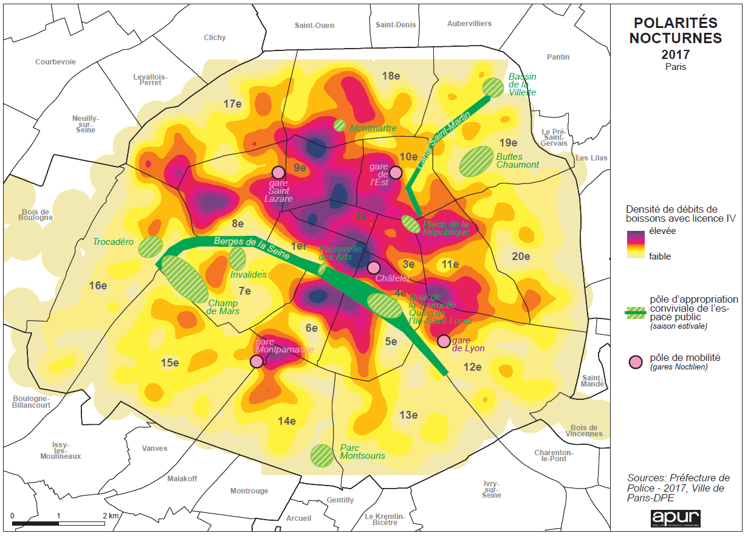

Slide 3
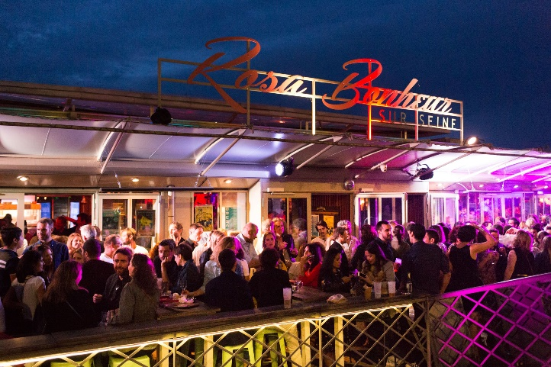
Paris at night
15K bars and restaurants (25% of the shops)
170 night clubs
+600 venues open after 2 am
83K nightlife workers (13% of those working after 9 pm)

Slide 4


Slide 5

Sharing practices from…
Bordeaux
Budapest
Liège
Mannheim
Nantes
Paris
Rotterdam
Turin
Vilnius
Zurich

Slide 6
Thematics
Gouvernance
Political and operational management
Process
Starting
Action plan
Reporting
Communication
Process evaluation
Strategy
Diagnosis
Implementation
Evaluation
Bodies
Stakeholders

Slide 7

GOUVERNANCE

Slide 8
GOUVERNANCE : Political lead
Who has the legitimacy to politically carry a comprehensive approach involving various sectoral elected officials and partners?
The Mayor: Liège, Turin
A dedicated Deputy Mayor: Bordeaux (from 2020), Firenze, Nantes, Paris, Vilnius
A group of Deputy Mayors: Bordeaux (until 2020)
A recruited « Night Mayor »: London, Tbilissi
An external « Night Mayor »: Amsterdam, Berlin, Mannheim
An external « Night Mayor Council »: Zurich
Dedicated elected officials at the district level: Paris
J
Global political vision
Visible political willingness
Legitimated by the Mayor
L
Competition between elected officials
Political alternation
Disparity between districts

Slide 9

GOUVERNANCE : Operational management
1 transverse project manager:
Coordinating the city services, networking
Supervizing implementation
Evaluation, communication
1 dedicated project team
Nighttime referents Nuit in the department/services
J
Legitimate project manager towards other services and partners
Win-win strategy with services and partners
L
Resistance from an organization in silos
Not a priority for other services
Lack of resources

Slide 10
GOUVERNANCE : The stakeholders
Groups | Stakeholders
Institutions | The municipality ; Law enforcement ; Surrounding cities, Region ; State agencies
Professional organisations | Bars, clubs and events unions, labour unions
Associations | In the field of culture, prevention, mediation, harm reduction, gender equality, inclusion, quality of life; etc.
Operators | Transportation, urbanists, cities’ networks, etc.
Citizens | Partygoers committee, neighbourhood committee
Qualified people | Artists, profesionnals, researchers, etc.
J
Existence of organizations representing professionals and inhabitants, prevention networks ...
Meeting everyone's needs and expectations
L
Opposition between stakeholders, divergences of interests
Lack of common culture

Slide 11
GOUVERNANCE : Bodies
Nightlife Council
Management
Working groups
Local commissions
Users committee
J
Clear operating system
Co-animation of working groups
Regular meetings but not too often ...
L
Lack of availability of stakeholders, turnover
Lack of common culture

Slide 12


Slide 13
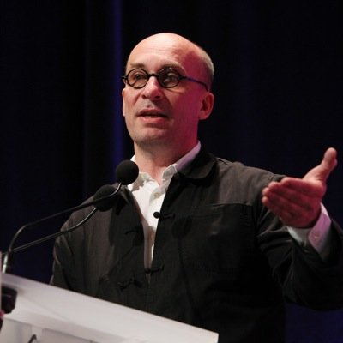
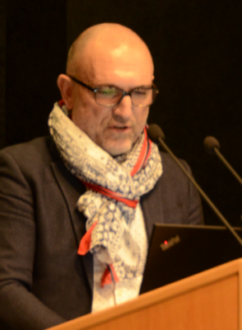
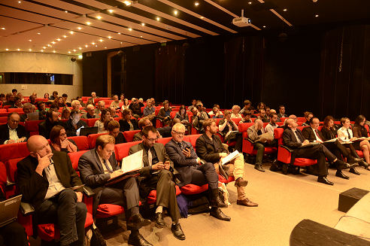
Frédéric Hocquard
Deputy Mayor for Tourism and Nighttime
Thierry Charlois
Chef de projet sur la Politique de la Nuit DDCT
Local dedicated elected officials
Points of contact
in each city department
Paris Nighttime Council

Slide 14
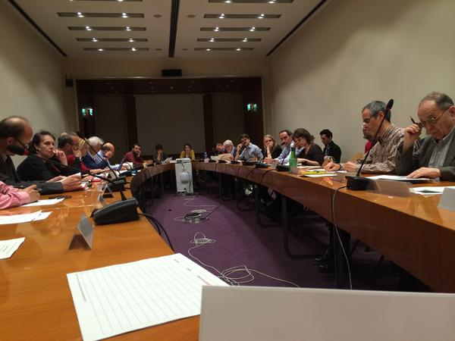
8 thematic working groups
New spaces for nightlife
Harm reduction
Inclusive nightlife
Mobility at night
Public safety
Trade and labour at night
Promotion
Sustainable development

Slide 15

PROCESS
Quick off
Diagnosis
Strategy development
Action plan development
Implementation
Evaluation of actions

Slide 16

PROCESS : Quick off and diagnosis
Bilateral meetings: Information, collection of partners' needs, expectations and resources
Data collection
Studies to complete the diagnosis
Diagnosis in progress
J
Win-win approach
Shared diagnosis
Mapping, cross diagnosis
L
Lack of resources
Difficulty to obtain data from partners

Slide 17

PROCESS : Strategy development
Establish the principles: balance between the needs of the different uses of nighttime, diversification of the offer, accessibility of the offer, inclusion, sustainable development...
Share objectives and strategy (finding consensus)
Explain the framework, the ability of partners to influence, etc.
J
Official kick-off meeting
Document describing the operating system
Flexibility
Co-writing a manifesto, a charter (the principles)
L
Hard to reach consensus between divergent interests

Slide 18
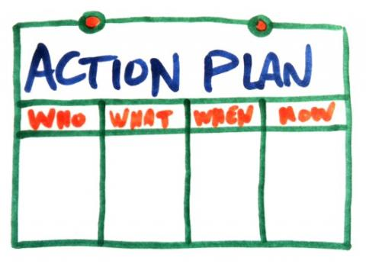
PROCESS : Actions development
Thematic working groups > specific and operational objectives ; concrete proposals
Developing and validating an action plan
Implementation and supervizion
J
Identify transverse actions
Support associations for implementation
Ad Hoc action groups
Regular communication during implementation
L
Multiple project managers
Various scope and duration of actions
Difficult planning
Lack of resources
Maintain group mobilization during implementation

Slide 19
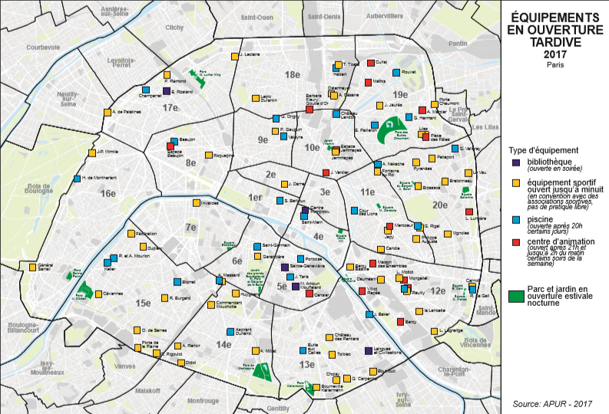

Slide 20
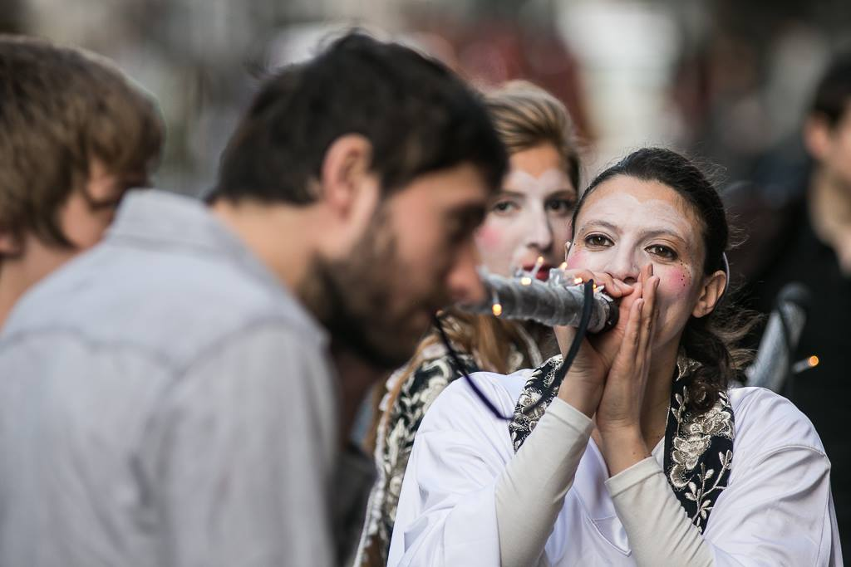

Slide 21
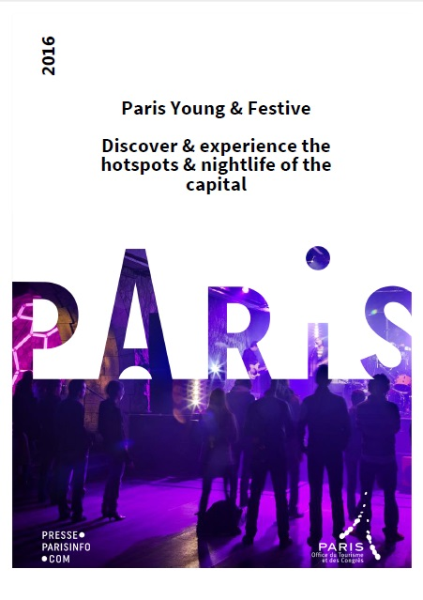
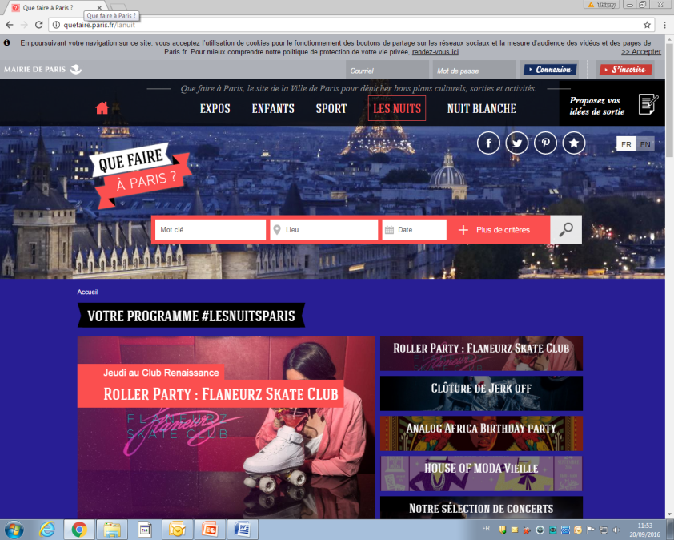
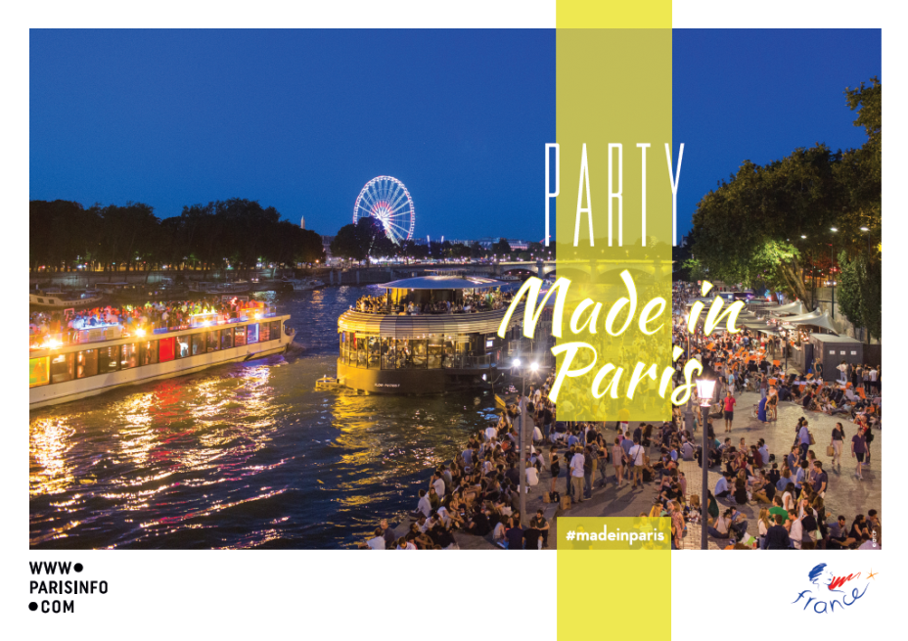
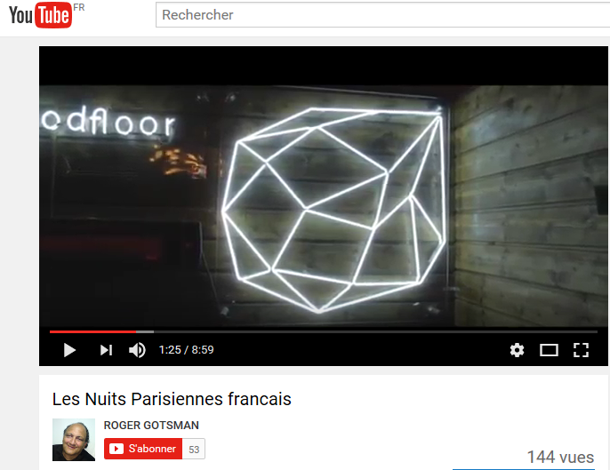

Slide 22

Reporting

Slide 23

REPORTING: Communication
Communiquer en interne (en amont du lancement) et pendant le processus (état d’avancement régulier, fiche de suivi, réunions de DG ou référents)
Animer le réseau : bilan annuel, newsletter, newsflash, réseaux sociaux, librairie numérique
Informer grand public : communiqués de presse, page web, etc.
J
Plan de communication
Identité de marque, identité visuelle
Transmettre aux partenaires les infos qui les concernent (gagnant-gagnant)
Valoriser les participants au projet (portrait, actions phares)
Notes:
Un point que je suggère :
Communiquer en interne (en amont du lancement) et pendant le processus (étant d’avancement

Slide 24
REPORTING : Evaluation of the participation
Efficacité : Le processus participatif contribue-t-il à l’élaboration d’actions partagées ?
Pertinence : Le processus répond-il aux attentes des parties prenantes?
Adéquation territoriale : Les dispositifs de concertation locale impulsés par le processus correspondent-ils aux besoins spécifiques locaux ?
Cohérence : Le processus est-il adapté au processus de décision de la Ville ?
Impact systémique : Le processus influence-t-il les pratiques de prise de décision en dehors de son périmètre ?
Efficience : Le rapport entre les ressources mobilisées et les résultats obtenus est-il satisfaisant ?
J
Entretiens qualitatifs
Communiquer sur les résultats
Prendre en compte les préconisations des partenaires
L
Frustration des partenaires : attentes vs résultats (temps institutionnel, manque de ressources)

Slide 25
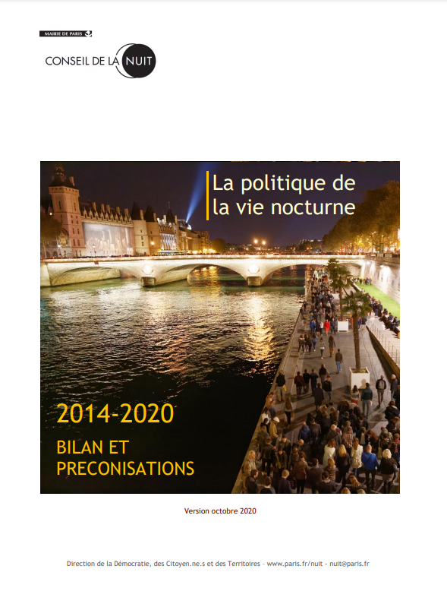

Slide 26
www.paris.fr/nuit
FB : ConseilNuit
nuit@paris.fr
https://vienocturne.eu/

